Slide 1
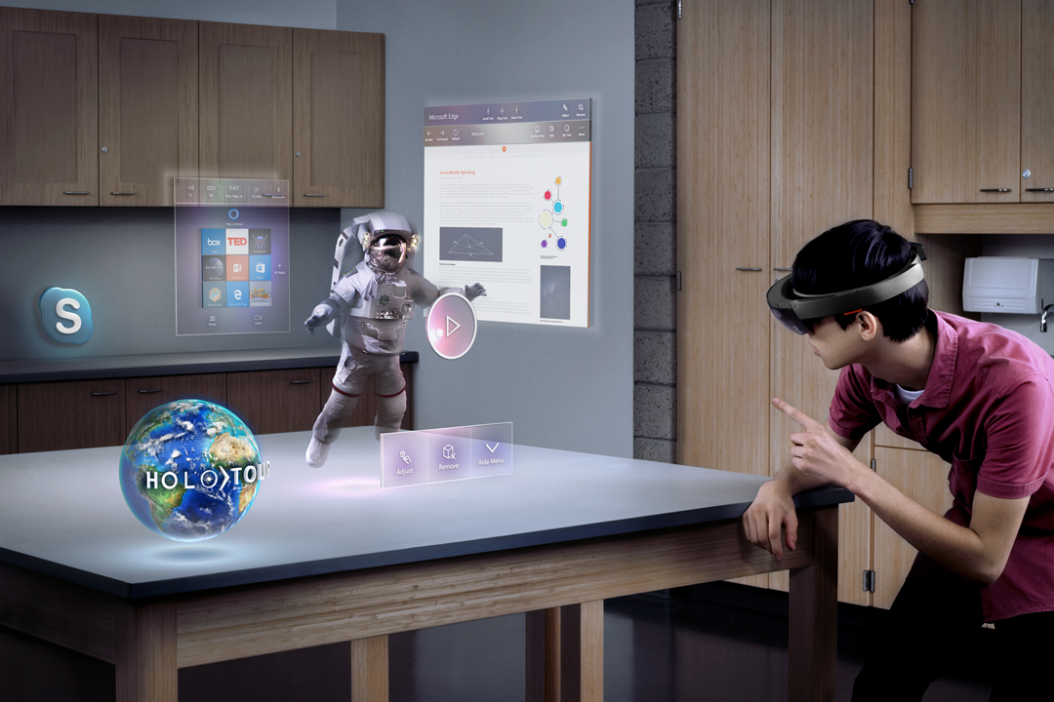

Mixed Reality e Speech API facciamo parlare HoloLens in italiano Marcello Marchetti Senior Technical Evangelist, Microsoft @marcello_twit

Slide 2
What is mixed reality?
Notes:
First of all, what is mixed reality?

Slide 3

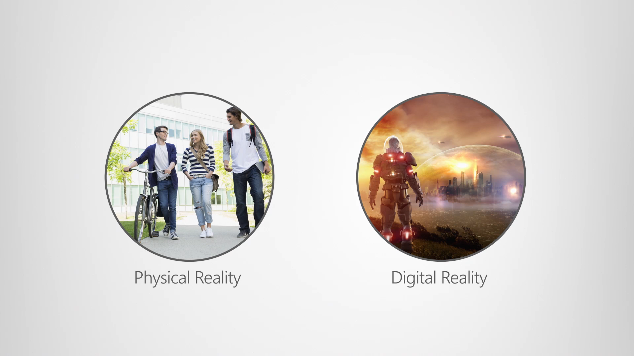

Slide 4
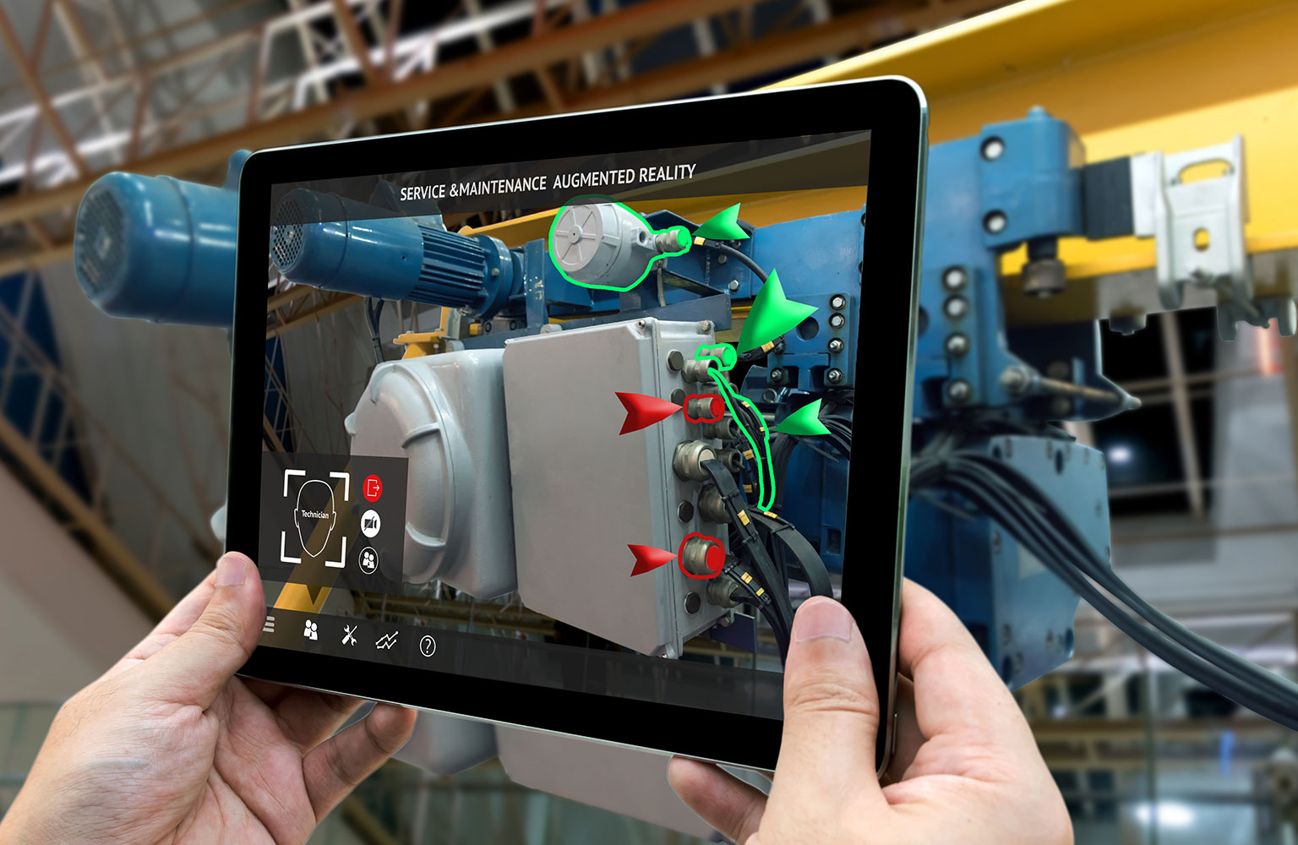
Mixed reality is experienced in a spectrum – The RV continuum
Augmented Reality

Slide 5
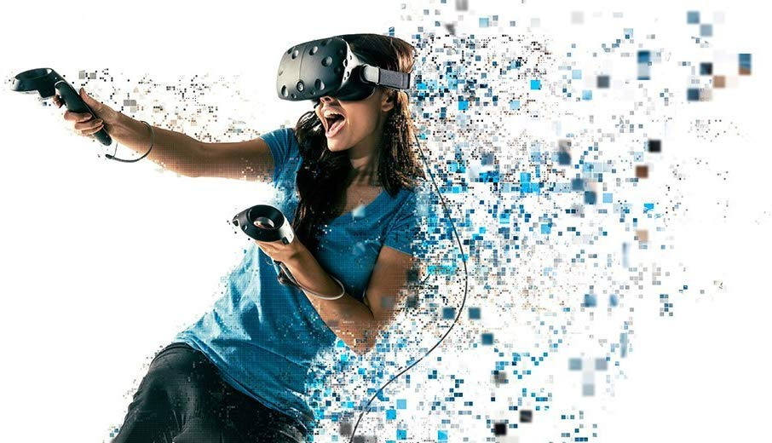
Mixed reality is experienced in a spectrum – The RV continuum
Augmented Reality
Virtual Reality

Slide 6
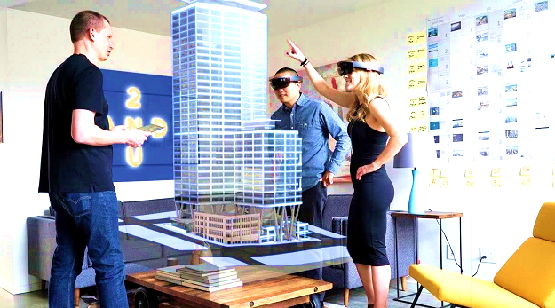
Mixed reality is experienced in a spectrum – The RV continuum
Augmented Reality
Virtual Reality
Mixed Reality – Holographic headsets
Mixed Reality – Immersive headsets

Slide 7
Our devices deliver distinct experiences across the mixed reality spectrum
Physical Reality
See-through
Mobile Performance
Portable
Tethered
Desktop Performance
Immersive
Virtual Reality

Slide 8









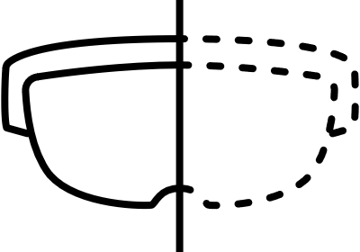
Windows Mixed Reality
Enables development across a multitude of devices
Universal Windows Platform
Mixed Reality

Slide 9
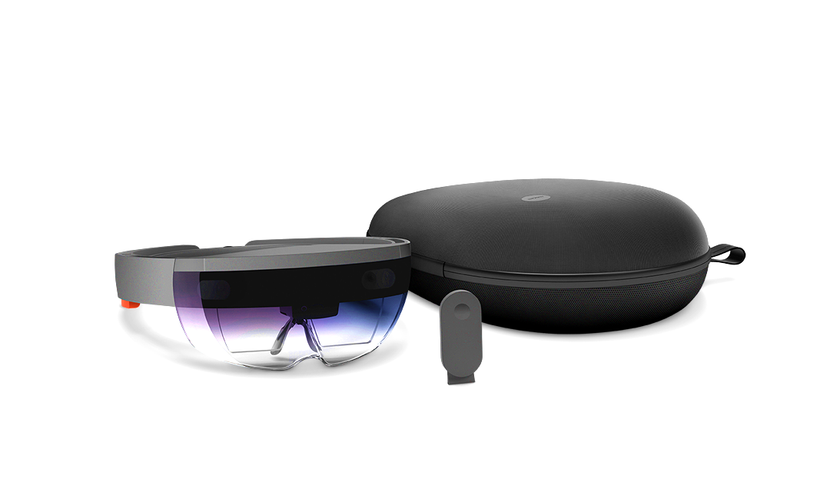
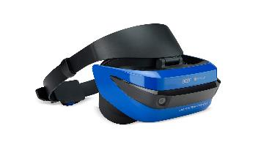
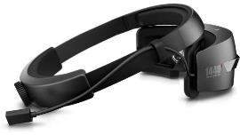
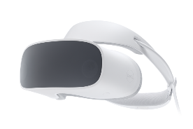
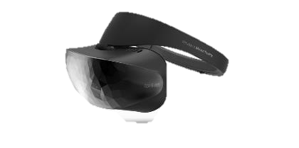
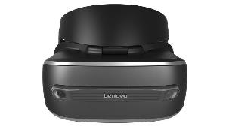
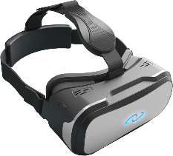



Microsoft HoloLens
Our wide range of devices enables organizations to choose the ones that best meet their needs, and scale their investment by having one platform for all mixed reality experiences
Mixed reality device partners

Slide 10
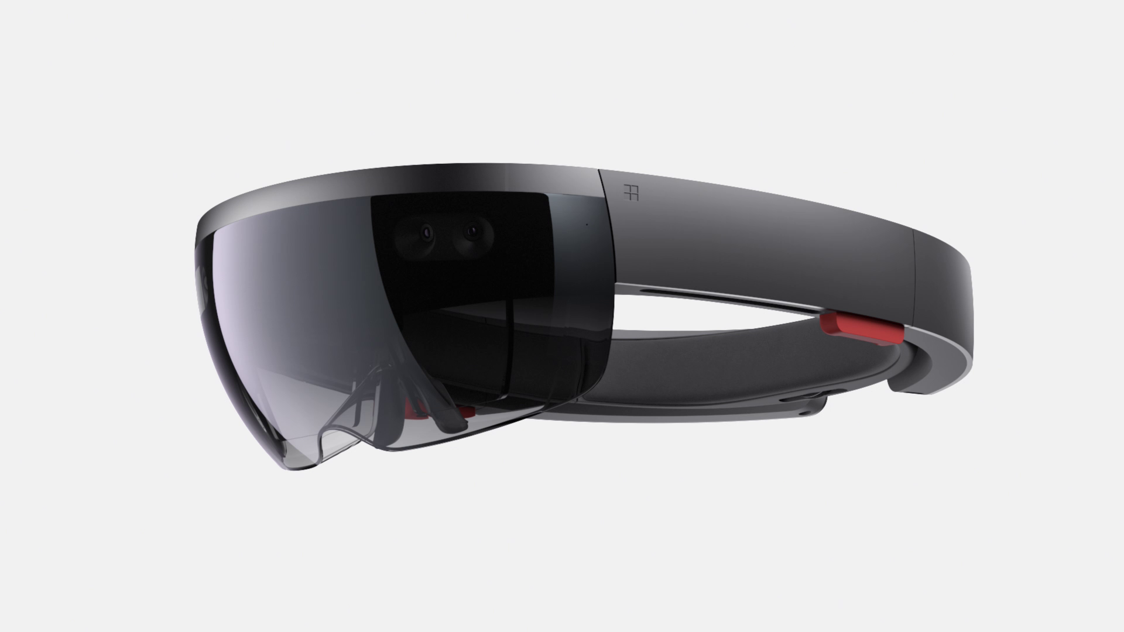
Untethered computer
Containing more computing power than the average laptop, Microsoft HoloLens doesn’t need external wires, markers, or cameras, nor a connection to a phone or PC, so you can move freely and untethered.
Notes:
64GB Flash
RAM 3 GB di cui 2 GB CPU e 1GB HPU
Peso 579g

Slide 11
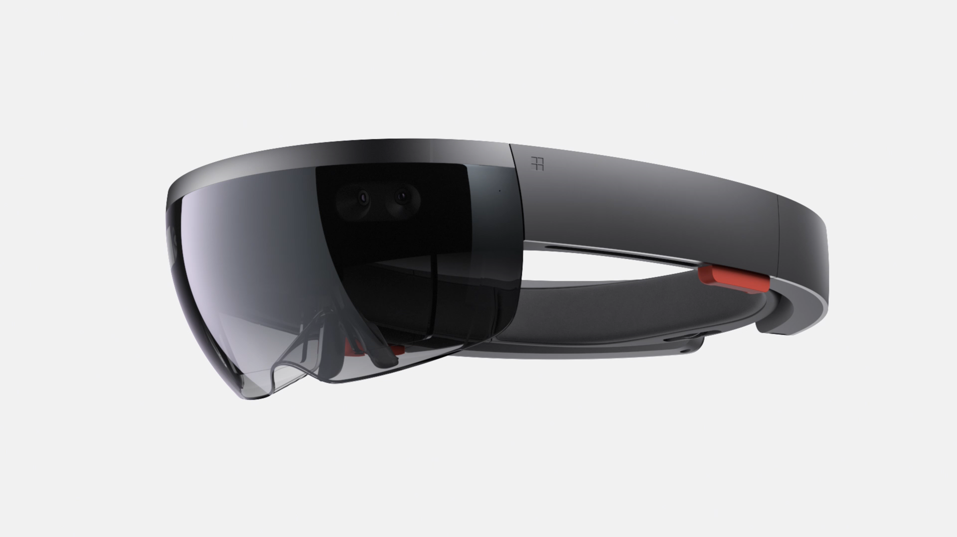
Advanced sensors
Microsoft HoloLens has advanced sensors to capture information about what you're doing and the environment you’re in.

Slide 12
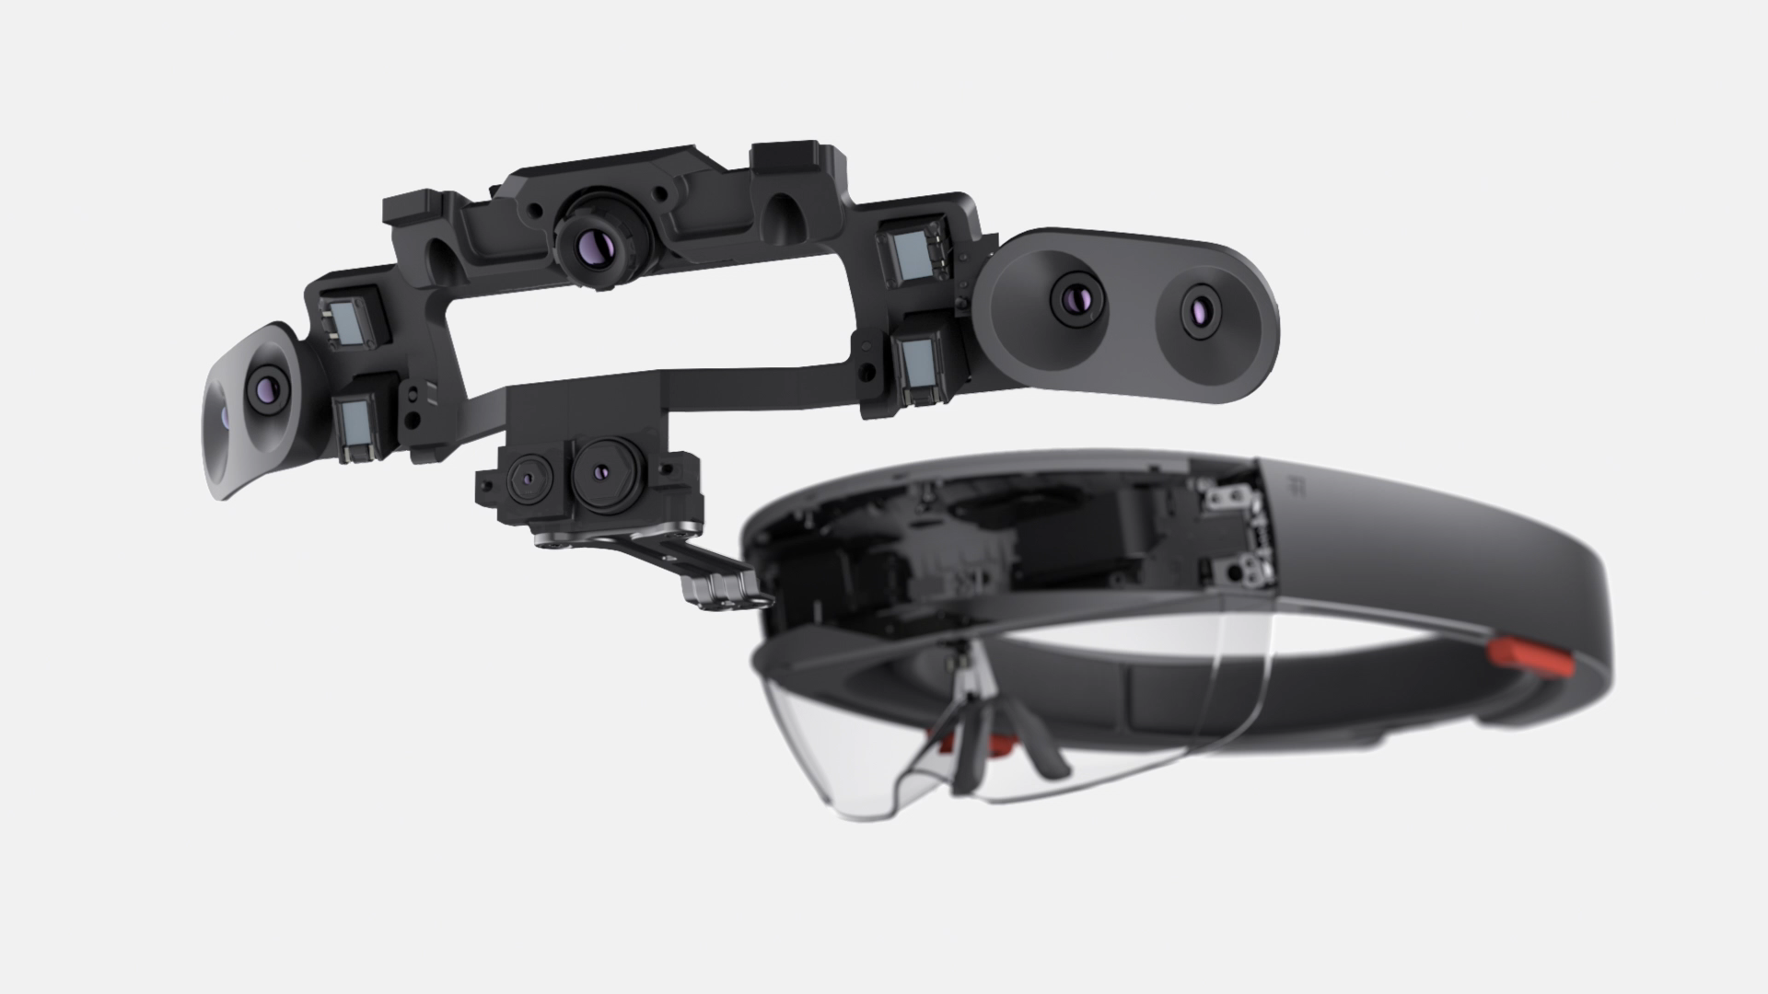
Transparent lenses
See-through holographic lenses use an advanced optical projection system, so you can see holograms in your world.
Notes:
2 Sorgenti luce HD rapporto 16:9
1 Sensore IMU unità di misurazione inerziale
4 Fotocamere di comprensione ambientale
1 Fotocamere di profondità
1 Video camera 2MP, HD
1 Sensori di luce ambientale

Slide 13
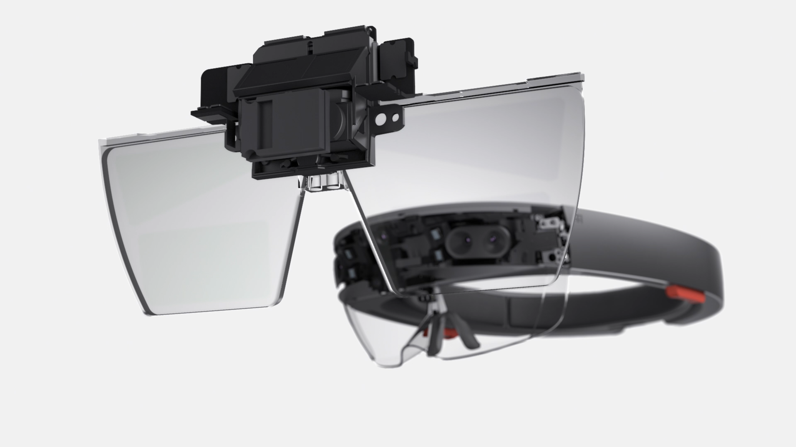
Holographic Processing Unit
The HPU is custom silicon that processes a large amount of data per second from the sensors, enabling Microsoft HoloLens to understand gestures, where you look, and map the world around you, all in real time.
Notes:
2 Lenti olografiche trasparenti
Calibrazione automatica pupillare
Risoluzione olografica 2,3 milioni di punti luce
Densità olografica Superiore a 2.500 punti per radiante

Slide 14

Spatial sound
Microsoft HoloLens synthesizes sound so that you can hear holograms from anywhere in the room. It’s immersive, yet won’t block out the real world.
Notes:
4 Microfoni
Altoparlanti Integrati
Cuffie Supporto jack 3.5 mm

Slide 15
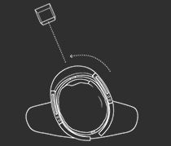
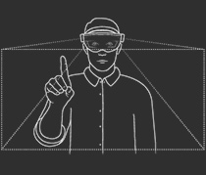
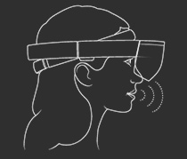
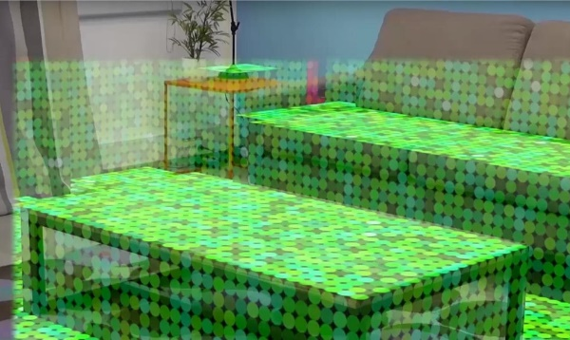
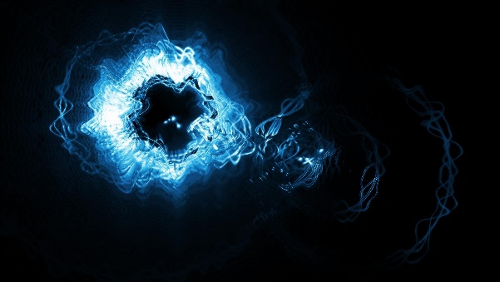
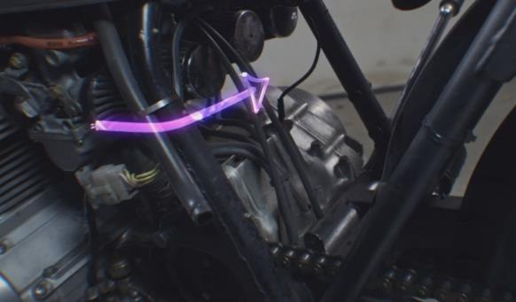
A new way to interact
Gaze
Gesture
Voice commands
Spatial mapping
Spatial sound
World coordinates

Slide 16
